Slide 1
ATS Resident Boot Camp: Bronchoscopy 101 & Advanced Bronchoscopy
Bronch 101 Leads: Melissa New, MD & Van Holden, MD
Adv Bronch Leads: Laura Frye, MD & Van Holden, MD

Slide 2
Boot Camp Overview
128 incoming fellows
Flow: 2 Tracks
Amberson: small groups in the morning, hands-on in the afternoon
Trudeau: hands-on in the morning, small groups in the afternoon
Schedule
May 7 at 6 PM: RBC Virtual Live Introduction to Bronchoscopy (let us know if you’re available!)
Fri, May 16: RBC Bronch 101 8AM – 5PM
Sat, May 17: RBC Advanced Bronch 7AM – 4PM

Slide 3
RBC Virtual Live Introduction to Bronchoscopy
Wednesday, May 7, 2025, 6:00 pm EST
(not all attend the in-person RBC)
List the indications and contraindications to flexible bronchoscopy.
Describe the elements of informed consent for bronchoscopy, including risks of the procedure.
Compare various scope sizes and types (disposable vs. non-disposable).

Slide 4
Pre-reading & Resources Posted to Wiki Site
Best of ATS Lecture Series on Intro to Bronchoscopy https://www.thoracic.org/professionals/clinical-resources/video-lecture-series/bronchoscopy/
Bronchoscopy International https://bronchoscopy.org/bronchatlas
Olympus BronchoGuide phone app
Atlas of Flexible Bronchoscopy by Pallav Shah
Wahidi MM, et al. American College of Chest Physicians consensus statement on the use of topical anesthesia, analgesia, and sedation during flexible bronchoscopy in adult patients. Chest 2011.
Notes:
Not posted yet

Slide 5
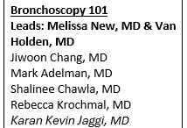
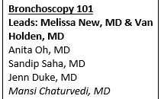
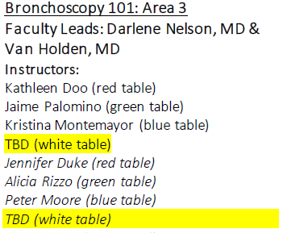
Bronch 101 Day
Ballroom C
Ballroom C

Slide 6
Bronch 101 Learning Objectives
Identify the components of the flexible bronchoscope.
1
Recognize the basics of airway anatomy.
2
Describe how to safely manipulate tools in the bronchoscope's working channel.
3
Describe use of foreign body retrieval devices.
4

Slide 7
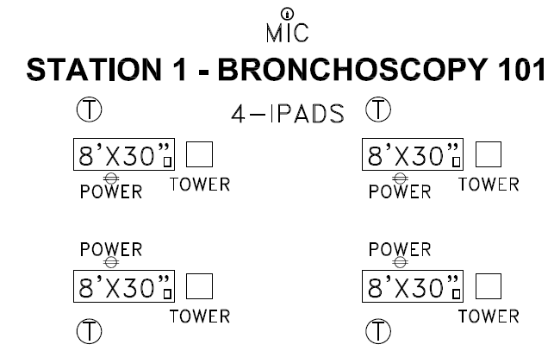
Bronch 101 Station
Each Table will have 1-2 Faculty and 4 Learners for the Duration of the Session, ~50 minutes
**2 scopes with airways per table
Each Table Will Have:
1 Olympus 190 tower with bronchoscope
1 lower airway lung model
Variety of foreign bodies
1 Ambu aView2 monitor with bronchoscope
1 complete airway model
Tools: forceps, spiral basket, cytology brushes, TBNA needle
1 I-Pad loaded with PPTs
Goal is to maximize the learners’ hands-on time

Slide 8
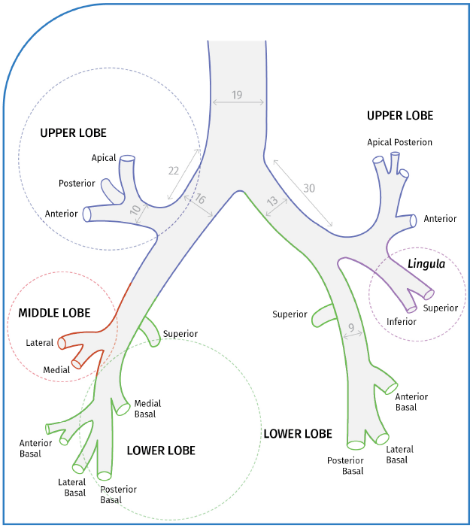

Slide 9
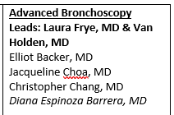
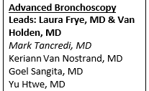
Advanced Bronch Day
Ballroom C
12-3:40 PM
Ballroom C

Slide 10
Advanced Bronch Learning Objectives
Recognize the components of the endobronchial blocker.
1
Identify appropriate attachments for the endobronchial blocker adapter.
2
Describe components of the EBUS scope and indications for use.
3

Slide 11
Advanced Bronch Station
Each Table will have 1-2 Faculty and 4 Learners for the Duration of the Session, ~50 minutes
Each Station Will Have:
1 EBUS tower (Olympus or Fuji)
1 lymph node model
1 Ambu aView2 monitor with bronchoscope
1 complete airway model
1 Arndt endobronchial blocker
Tools: forceps, spiral basket, cytology brushes, TBNA needle
1 I-Pad loaded with PPTs
Goal is to maximize the learners’ hands-on time

Slide 12
Notes
Be aware of potential equipment issues that may arise and improvise.
Please, arrive 5-10 minutes early to review and check your station.
We will send you Powerpoints that will be on the iPAD.
Please, make sure to talk to your table partner from the beginning to decide who will do what on the table.
Remember to:
Discuss Objectives with the participants to ease their level of anxiety before using a bronchoscope for their first time.
Create the “Right atmosphere” for them to learn and to ask questions
Manage your Time for teaching theory and practice, and time for the participants to ask questions.
Keep all the participants “Engaged”
Have fun by teaching and learning
Notes:
This is an overview of bronchoscopy and the intention is NOT to make them proficient on this.

Slide 13
Contact Info
Van Holden
732-668-2712
Melissa New
847-602-7283
Laura Frye
785-230-8566
Notes:
Let us know of any cancellations.

