Slide 1
Kahoot instructions

Slide 2
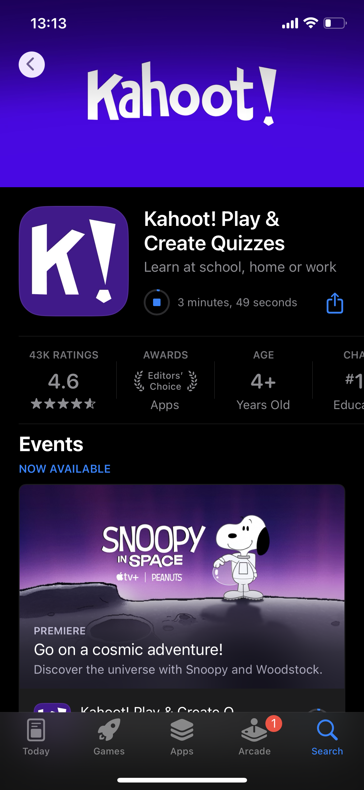
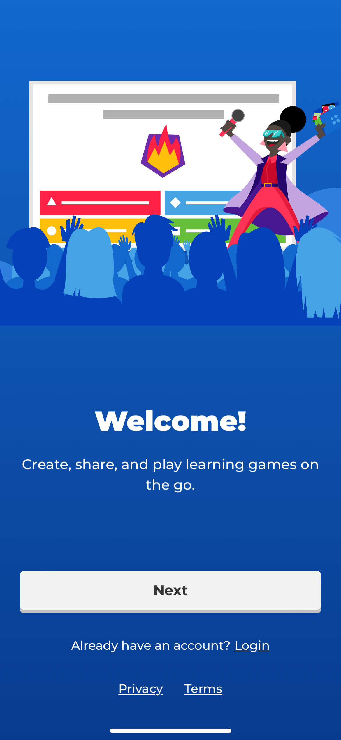
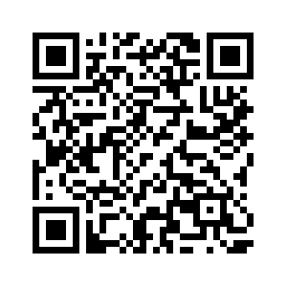
Download the Kahoot! app
Login or create an account

Slide 3
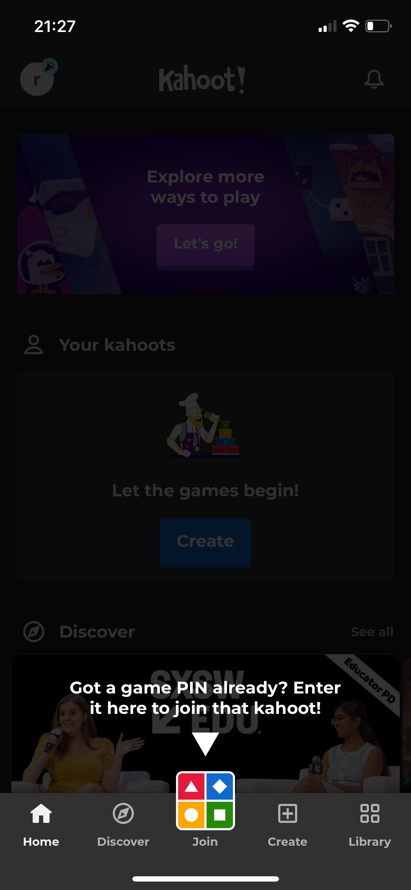
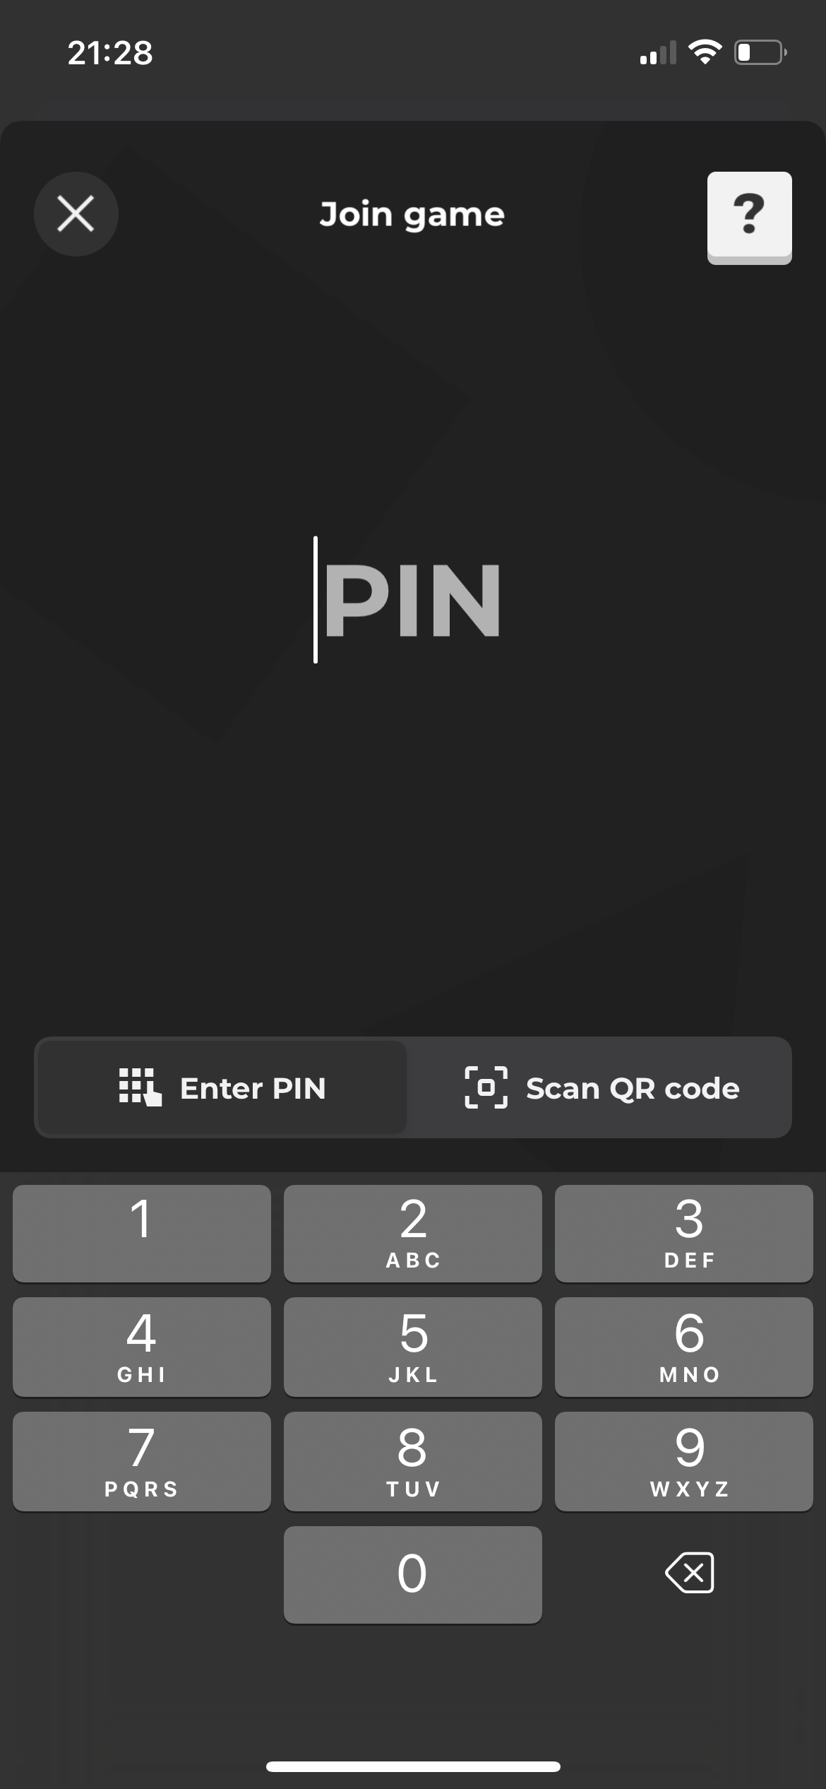
When prompted, enter the PIN provided or scan the QR code

Slide 4
Select your team* and enter a name
For Virtual RBC, use your name
*According to track assignment, which can be found on your badge

Slide 5
To help with communication, please join the WhatsApp group

