Slide 1

Ventilator Management
Virtual Session
ATS RBC 2025
Kavitha Bagavathy, MD Ren Ashton, MD

Slide 2
ATS RBC Wiki Site – Get your primer here
2024 Boot Camper Wiki Site
URL: https://thoracic.atlassian.net/wiki
Username: rbcattendee@thoracic.org
Password: BootCampAttendee!
Notes:
Needs new URL and QR code!

Slide 3
The assumptions today -
Safe space to learn
We’re all learning together
Your answer may be wrong, but we guarantee you weren’t the only one thinking what you said.
We all learn better if we interact with each other, so if you don’t volunteer to answer our questions, we might call on you.
  We’re not mean. We’re not picking on you.
  Most of the people on this call have no idea who you are . . .
  We want you to participate and learn.
  It’s fine to participate without being called on.

Slide 4
Some Basics

Slide 5
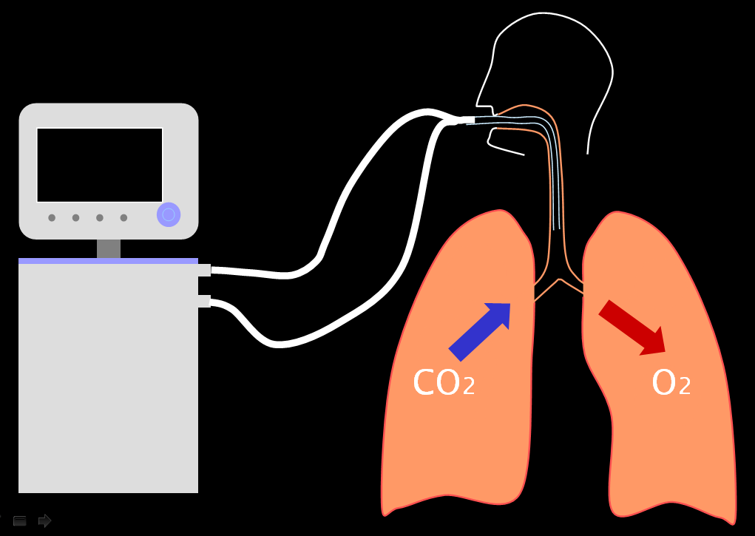
Control Variables
Inside every vent is a . . .
Union monkey,
Who will do whatever
you tell him to do,
but you have to
worry about the
rest.
The monkey has 2 knobs —volume and pressure.
You can put the monkey in charge of either knob, but not both→
Volume Control and
Pressure Control
modes.
Union monkey
with cup of coffee
and clock
Notes:
Let’s talk about some basic characteristics of ventilator modes. The first is the control variable. This means the parameter that the ventilator (or the monkey inside) is watching and adjusting according to your specifications to achieve the goals of ventilation. For our purposes, this is always either volume or pressure, but it usually cannot be both (more on next slide).

Slide 6
The Equation of Motion
When the patient is Passive ( no effort)
P_{vent} = P_{elastic} + P_{resistive}
Pressure_{vent} = Elastance x Volume + Resistance x Flow + PEEP_{total}
You can tell the monkey to manage either side of the equation, but you have to worry about the other side.
  If monkey does pressure → control variable is pressure (“pressure control mode”)
    Alarms will tell you when volumes or flows are too low
  If monkey does volume & flow → control variable is volume (“volume control mode”)
    Alarms will tell you when pressures are too high
Notes:
P_{vent =} Elastance x Volume + Resistance x Flow

Slide 7
The respiratory cycle on a ventilator:
What signals the start of inspiration?
  (Also called the trigger)
  “Triggering” can be due to . . .
  Preset time since last breath
  Patient-generated pressure drop
  Patient-generated inward air flow
What signals the end of inspiration?
  (Also called the cycling variable)
  “Cycling” can be based on . . .
  Preset time since triggering
  Preset volume target reached
  Preset flow target reached
inspiration
triggering
cycling
expiration

Slide 8
Breath Types (2 types)
Mandatory breaths
  Breaths are either triggered, cycled or both by the machine
Spontaneous breaths
  Breaths are both triggered and cycled by patient
CMV = continuous mandatory ventilation (all breaths mandatory)
CSV = continuous spontaneous ventilation (all breaths spontaneous)
IMV = intermittent mandatory ventilation (some of each)
Breath Sequence (3 sequences)
To look forward to as fellows:
“Targeting schemes” – what makes modes with the same control variable and breath sequence distinct from each other . . .

Slide 9
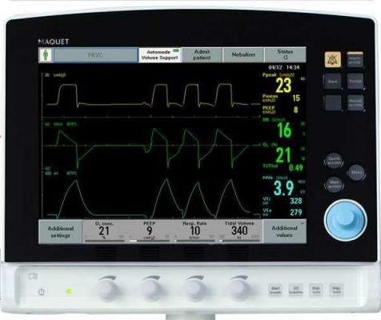
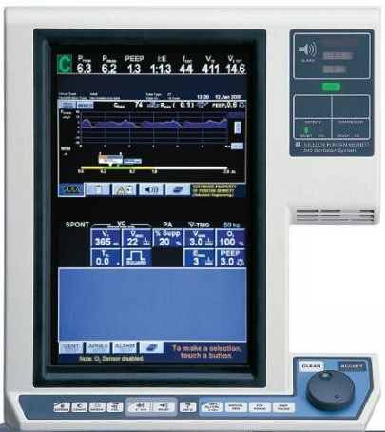
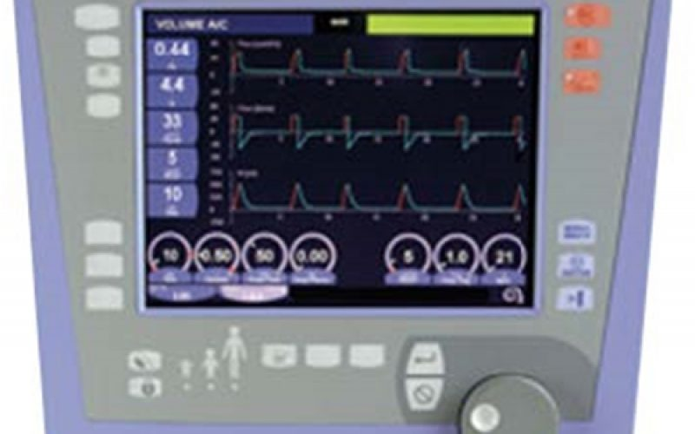
Knob-ology
Find the input areas
Find the output areas
Learn how to select a parameter and change the setting
  Most vents now have touch screens and a system with control knob/accept
Learn how to display waveforms and which ones are most useful
Learn how to perform inspiratory and expiratory holds
Maquet Servo-i
Puritan Bennett 840
Carefusion Avea

Slide 10
BREAK OUT SESSIONS START NOW

Slide 11
CASE 1: ARDS

Slide 12
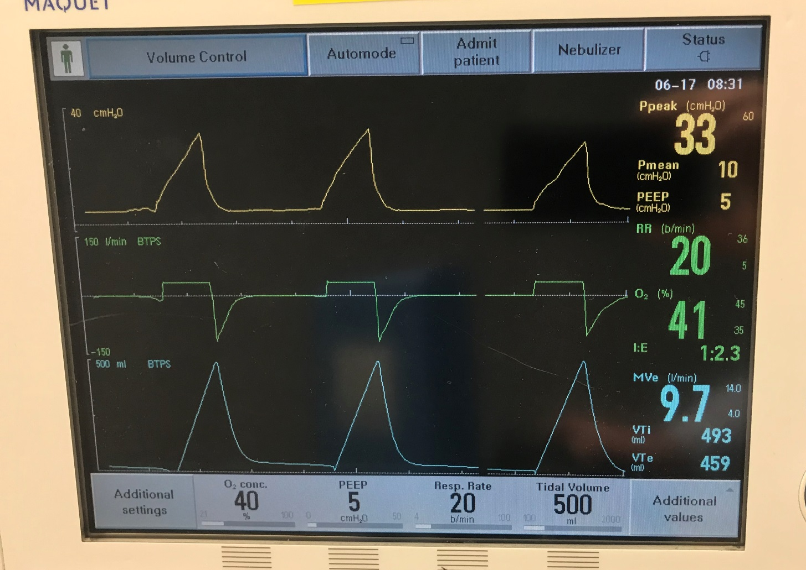
You receive a blood gas
pH 7.32
PaCO₂ 65 mmHg
PaO₂ 50 mmHg
Should we make any changes to the ventilator?
Notes:
Yes – PaO2 is below ARDS guideline recommended goal 55-80
What can we change that might help improve the O2?
- PEEP or FIO2%

Slide 13
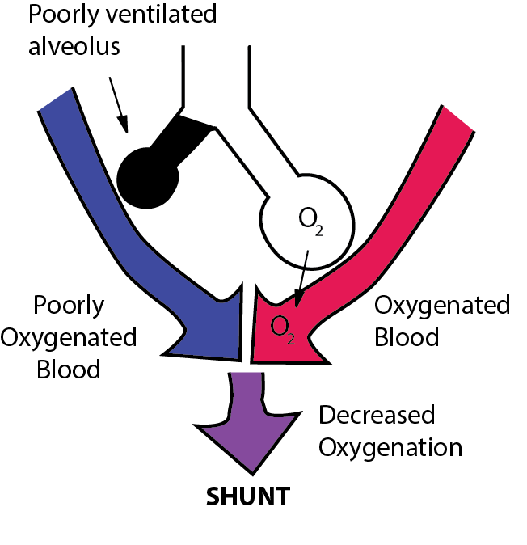



Why does PEEP help improve PaO2?
Atelectasis
Notes:
Decreases atelectasis and decreases shunt to improve V/Q mismatch

Slide 14
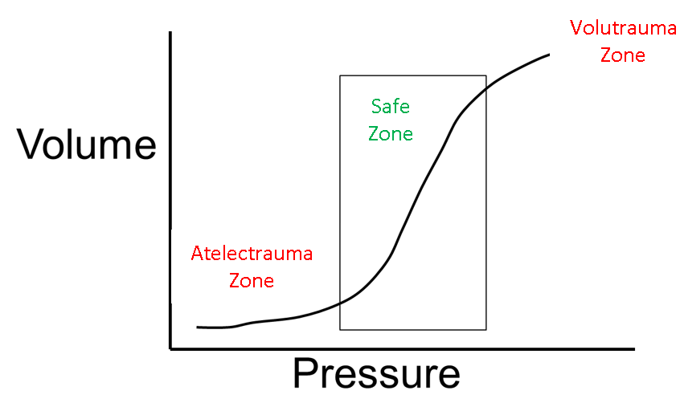


Another secret about PEEP
Notes:
In ARDS, surfactant dysregulation increases surface tension. Repeated alveolar closure in these situations increases inflammation, leading to ARDS proliferation. Discuss that PEEP also helps prevent this by keeping the PV curve in the “safe zone” between atelectasis and overdistention.

Slide 15

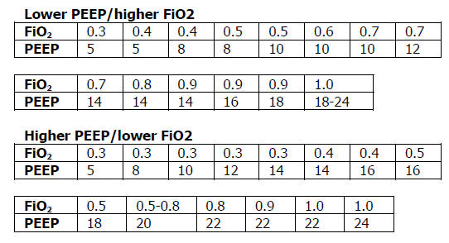

Which one should we adjust (PEEP or FiO₂)?
Notes:
Scan the QR code to get the ARDSNet Table
Note to learners that in both low PEEP and high PEEP table the next increment up for this patient would be to increase the PEEP.

Slide 16
Recap
Use PEEP and FIO₂ to adjust the PaO₂

Slide 17

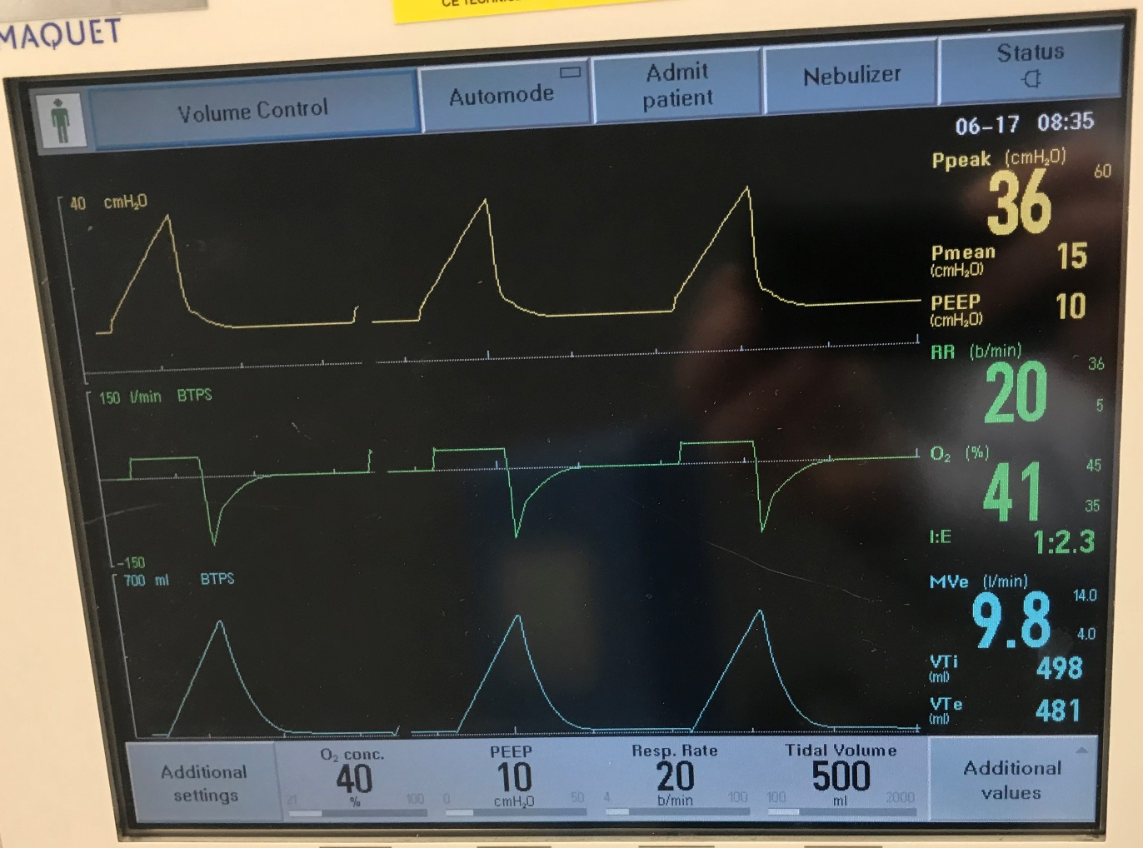
After adjusting the PEEP, what has changed?
Initial Settings
Current Settings
Notes:
GOAL: Review components that drive plateau (Tidal volume and PEEP)
The PEEP has changed from 5 to 10 and the peak pressure has increased from 33 to 36. (If your group is catching on quickly, note that this discrepancy implies improved compliance.)

Slide 18

How do we evaluate what is causing the high peak pressures?
P_{vent} = P_{elastic} +P_{resistive}
P_{vent =} PEEP + (Elastance * Volume) + (Resistance * Flow)
Peak Pressure
Plateau Pressure
Notes:
Refer to the equation of motion to show that the two components that make up the peak pressure are the elastic component (1/compliance) and the resistive component.
You can measure plateau pressure w/ inspiratory pause by removing the flow portion of the equation of motion

Slide 19
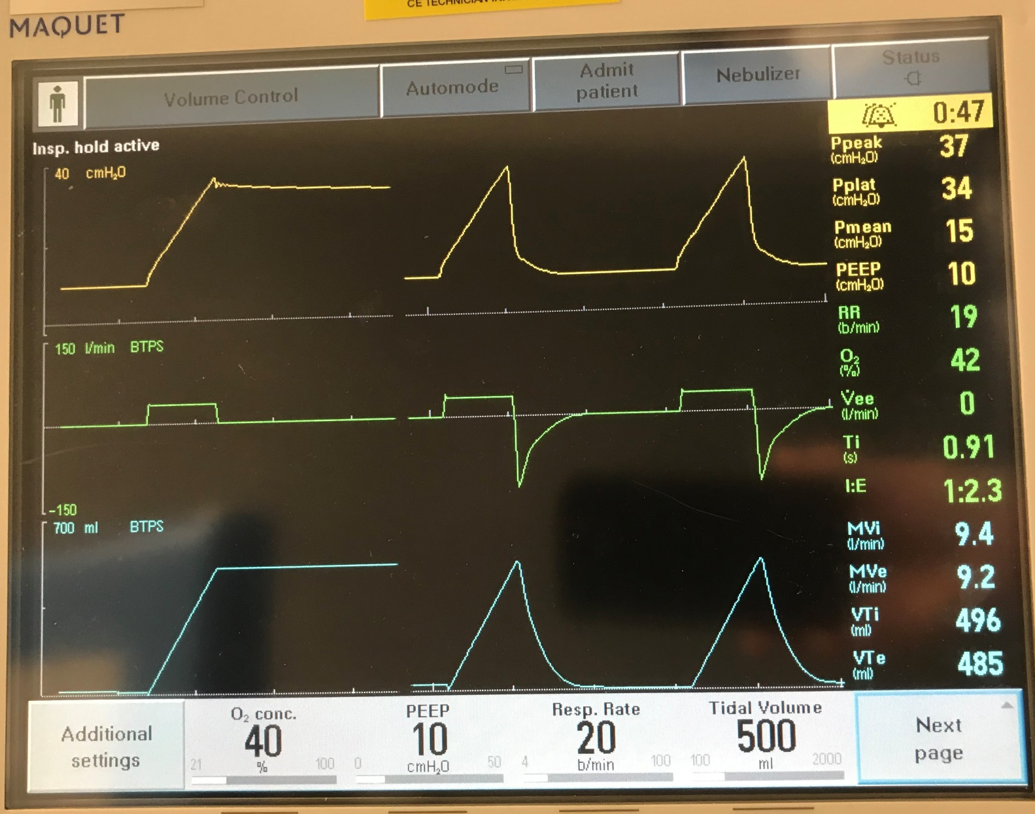
Plateau Pressure – No flow; measures lung elastance independent of flow and resistance
Inspiratory Hold
Notes:
GOAL: Review components that drive plateau (Tidal volume and PEEP)
POINT OUT THAT DURING INSPIRATORY HOLD THERE IS NO FLOW.

Slide 20
Back to the Pressure Volume Curve
Notes:
In ARDS, overdistention can also cause propagation of the ARDS. In this case the lung is being ventilated at high pressures, potentially injurious to remaining normal lung tissue. Concept = barotrauma

Slide 21
What can we change to lower the plateau pressure?
P_{vent =} PEEP + Elastance * Volume + Resistance * Flow
Inspiratory Hold
Notes:
Lower PEEP or Vt to change plateau pressure.

Slide 22
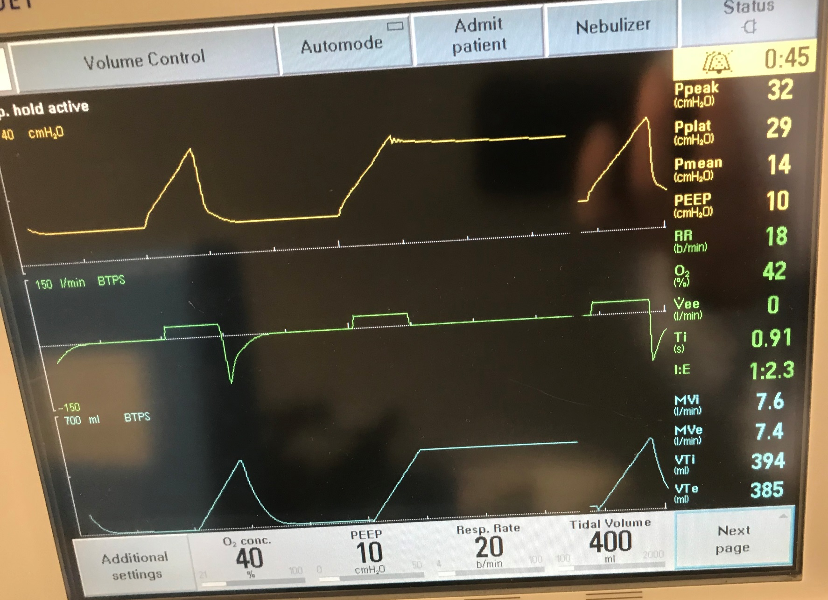
Notes:
Review components that drive plateau (Tidal volume and PEEP)
Lower Vt to decrease the Plateau pressure

Slide 23
With lower Vt, what might happen?
Notes:
PCO2 rises
Discuss goal to maintain minute ventilation. (increase Resp Rate)

Slide 24
With lower Vt, what might happen?
Notes:
Increase rate to maintain minute ventilation.

Slide 25
Recap
Use PEEP and FiO₂ to adjust the PaO₂
Use PEEP and Vt to adjust the plateau pressure
Use Vt and Rate to adjust the minute ventilation (and pCO₂)

Slide 26
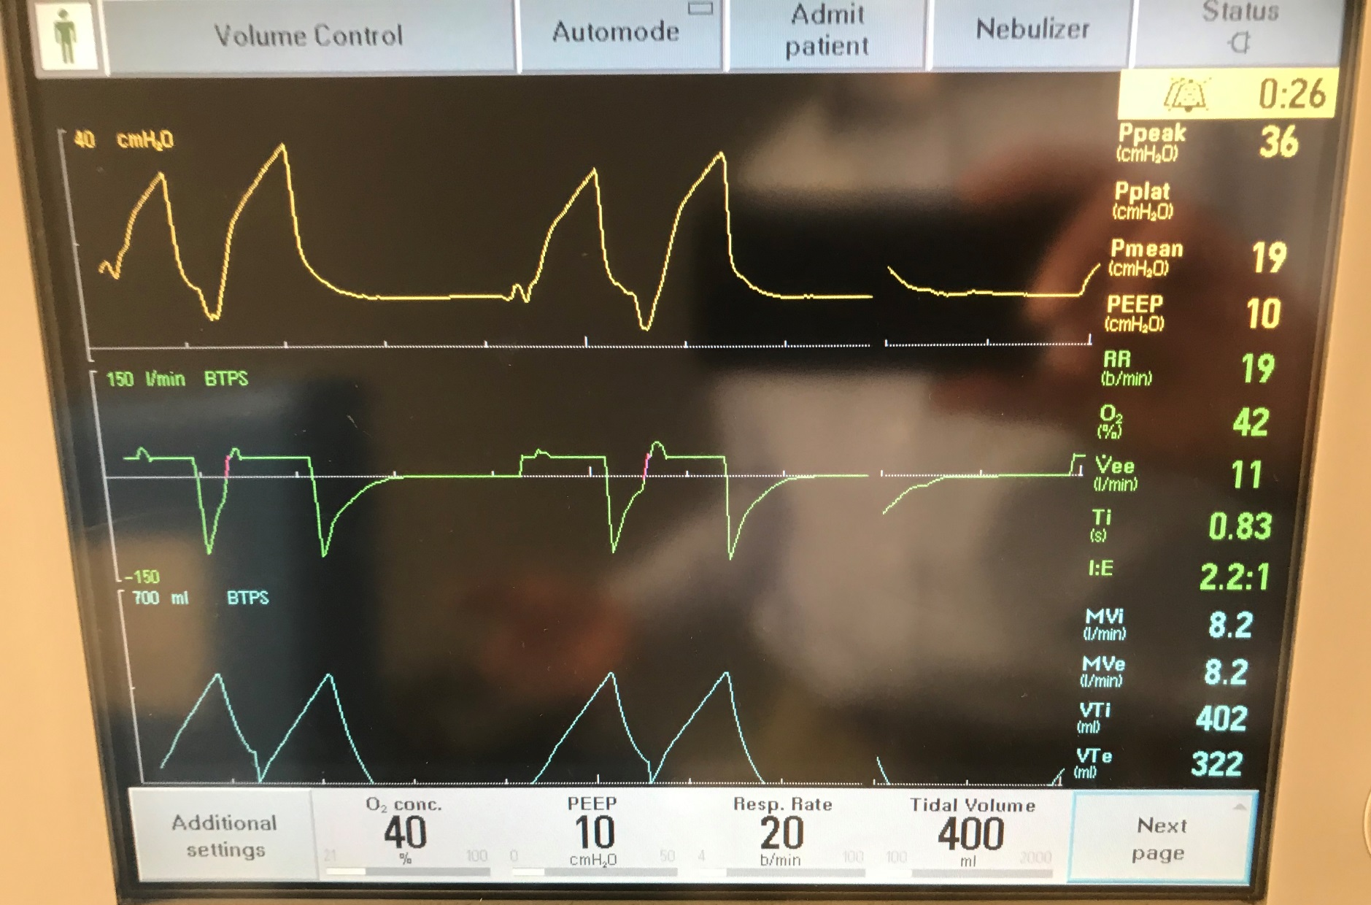
The patient’s sedation is decreased…
Notes:
ONLY If time – have patient double trigger vent.
Discuss how this creates a potential problem with overdistention
Discuss strategies to combat this dyssynchrony.
If time- discuss severe hypoxia strategies (proning, NO, ECMO etc)
Reiterate the need for excellent Vent Management w/ basic modes as 1st line.

Slide 28
CASE 2: ASTHMA

Slide 29
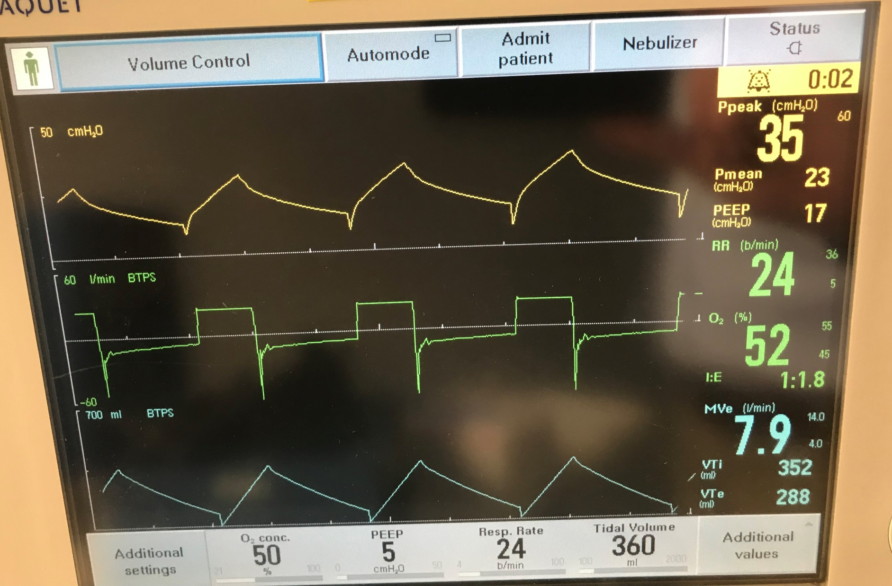
What is the problem with the vent waveform?
Notes:
GOAL: Recognize air trapping
Answer:
1. High peak pressures.
2. Air trapping on expiratory waveform – note this by expiratory waveform and high peak pressures.
Note that the peak pressure itself is not necessarily a problem. 2 reasons why peak may be high in this patient
Increased resistance
Air trapping leading to dynamic hyperinflation (AutoPEEP) – we will discuss this more in a bit.

Slide 30
How do we evaluate what is causing the high peak pressures?
P_{vent} = P_{elastic} +P_{resistive}
P_{vent =} PEEP + (Elastance * Volume) + (Resistance * Flow)
Peak Pressure
Plateau Pressure
Notes:
Refer to the equation of motion to show that the two components that make up the peak pressure are the elastic component (1/compliance) and the resistive component.
You can measure plateau pressure w/ inspiratory pause by removing the flow portion of the equation of motion

Slide 31
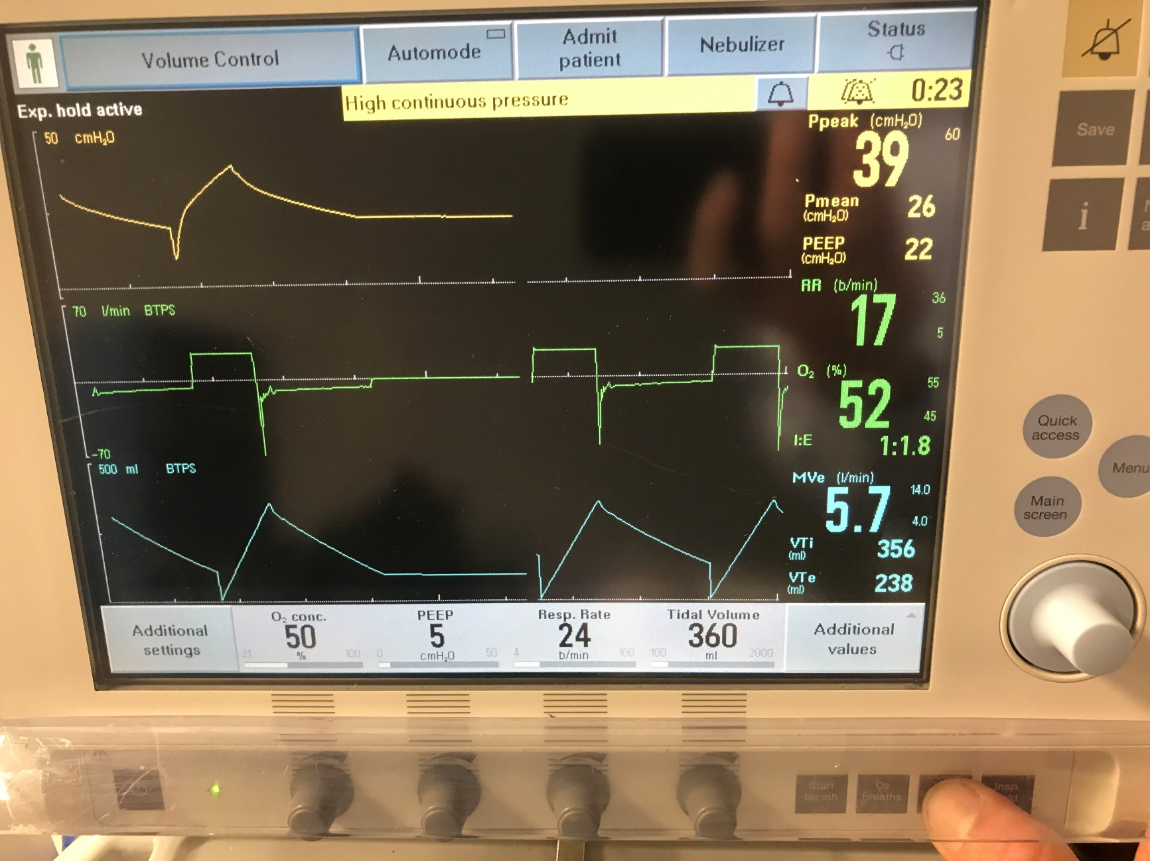
Is there air trapping or simply high resistance?
Expiratory Hold
Notes:
How do we determine what the cause of the resistance is?
2 reasons why peak may be high in this patient
1. Increased resistance – caused by asthma, kinked tube, secretions, biting etc. Need to evaluate this.
2. Air trapping is caused by dynamic hyperinflation (AutoPEEP)
- How do we evaluate for dynamic hyperinflation? (Picture of expiratory hold – see blue arrow)

Slide 32
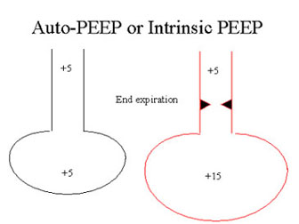
What is AutoPEEP?
Notes:
In normal lungs, expiration occurs very quickly. This occurs because the pressure in the lungs is higher than the pressure at the mouth and the natural recoil of the lungs and chest wall cause the patient to exhale until the pressure in the lungs and the pressure at the mouth (PEEP) are equal (left picture However, in a patient with obstruction (usually asthma or COPD), the ability to expire is prolonged. Therefore, the pressure in the lungs does not decrease as quickly as it normally would. We can see this on a ventilator by looking at the expiratory waveform. In a patient who has obstruction, it will take longer for the expiratory flow to reach zero. If the ventilator triggers a second breath before the exhalation phase is complete, some of the air from the prior breath is “trapped” in the lung. This can lead to a phenomenon called dynamic hyperinflation.
An end expiratory pause is simply a measure of the Static pressure of the lungs just before the ventilator triggers. If air trapping and dynamic hyperinflation are occurring, this will be demonstrated because the pressure generated by the inward elastic recoil of the lungs/chest wall will be higher than the PEEP (ie: the two are not at equilibrium).

Slide 33

For more on Auto-PEEP…
Best of ATS Video Lecture Series YouTube Video

Slide 34
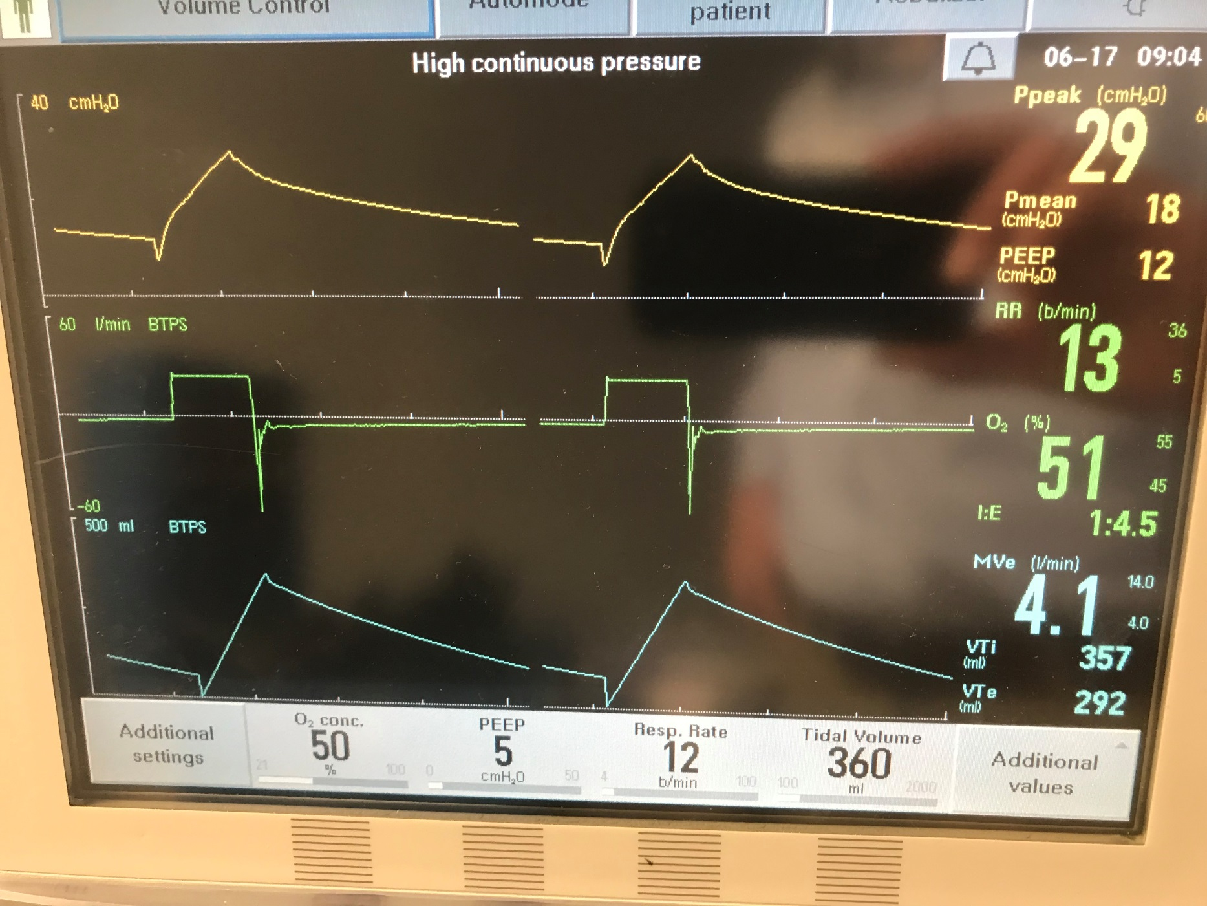
How might we correct AutoPEEP?
Notes:
Step 1: Increase expiratory time (lower rate, lower tidal volume or lower i-time)
Emphasize that lowering resp rate gives you the biggest increase in expiratory time relative to the other two parameters.
To maintain minute ventilation at lower rate, may have to increase Vt (only time where violating the 6-8cc/kg rule may be acceptable)
Discuss how to look for expiratory flow returning to zero at end expiration.

Slide 35
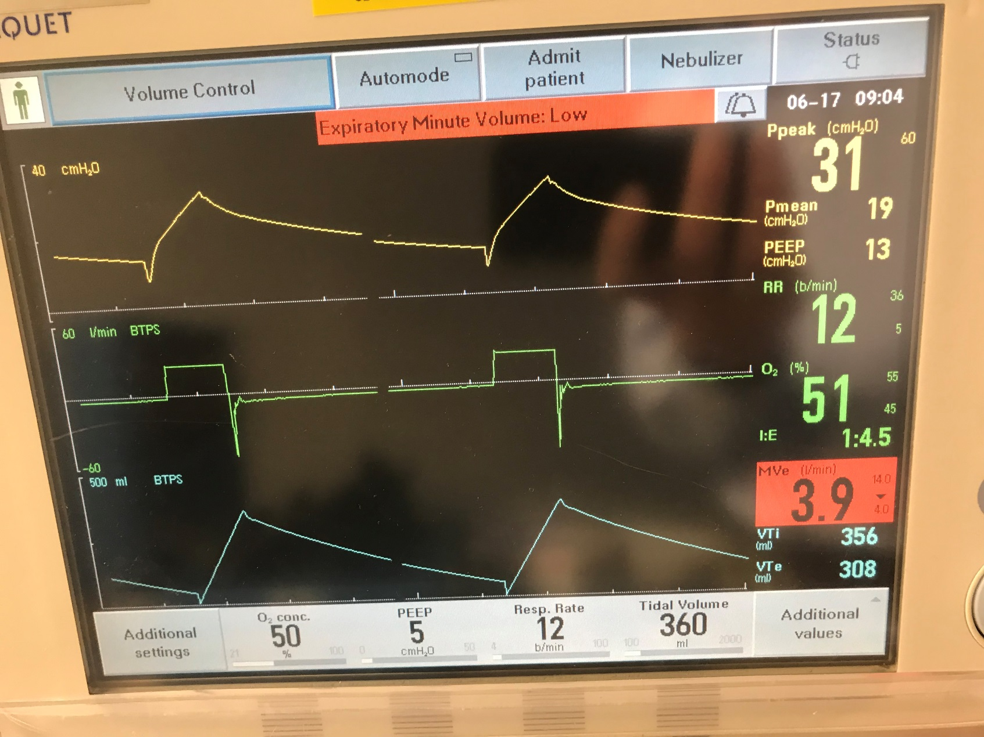
Uh Oh… what’s wrong now!
Notes:
The problem with lowering respiratory rate alone is that it will lower your minute ventilation.

Slide 36
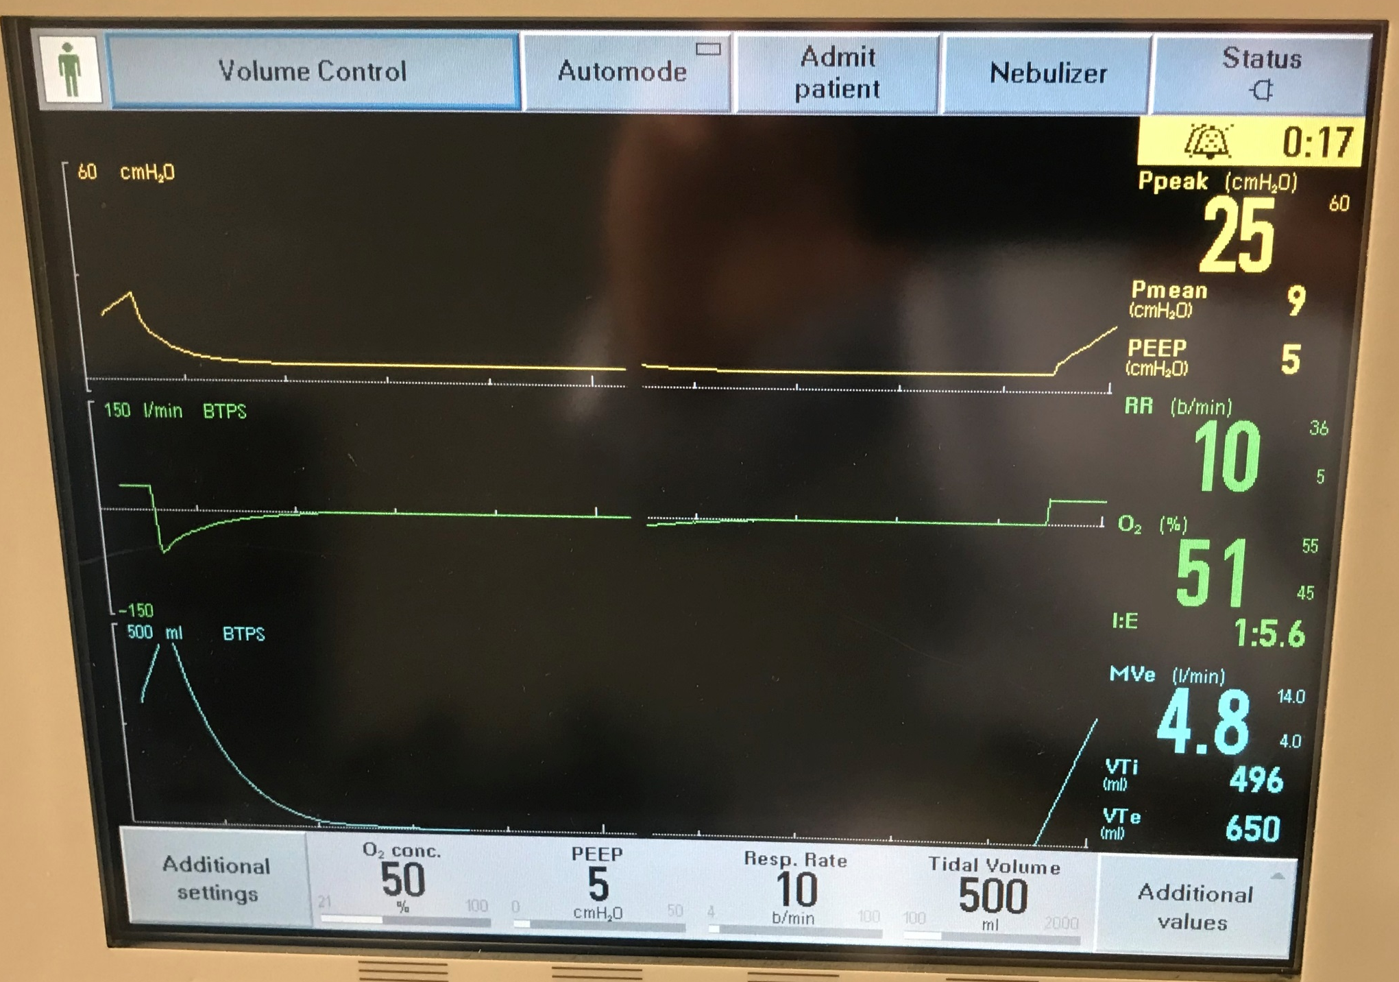
Notes:
Note that despite higher Vt, the marked increase in expiratory time allows the flow rate to go to zero (blue arrow).

Slide 38
LARGE GROUP

Slide 39
Key Points
Remember the equation of motion:
  P_{vent} = Elastance x Volume + Resistance x Flow (+ PEEP _{total})
Tidal volume and PEEP affect the plateau pressure
PEEP and FIO₂ affect PaO₂
Rate and tidal volume affect PaCO₂
Maximize expiratory time to prevent dynamic hyperinflation.
Look at the waveforms – usually FLOW helps you the most.
Don’t be afraid of the vent.

Slide 40
See you for more MV fun at the hands-on session in San Francisco !
Kavitha Bagavathy
Ren Ashton

